Slide 1
Process Planning Tools Assembly drawings, process flow diagrams, breakeven analysis (make versus buy)
BUSI 104 – Operations Management
Professor Ed Arnheiter

Slide 2
Process Planning Tools
Assembly drawings
Operations sheets
Process Flow diagrams (PF)
Process selection
Specific equipment selection

Slide 3
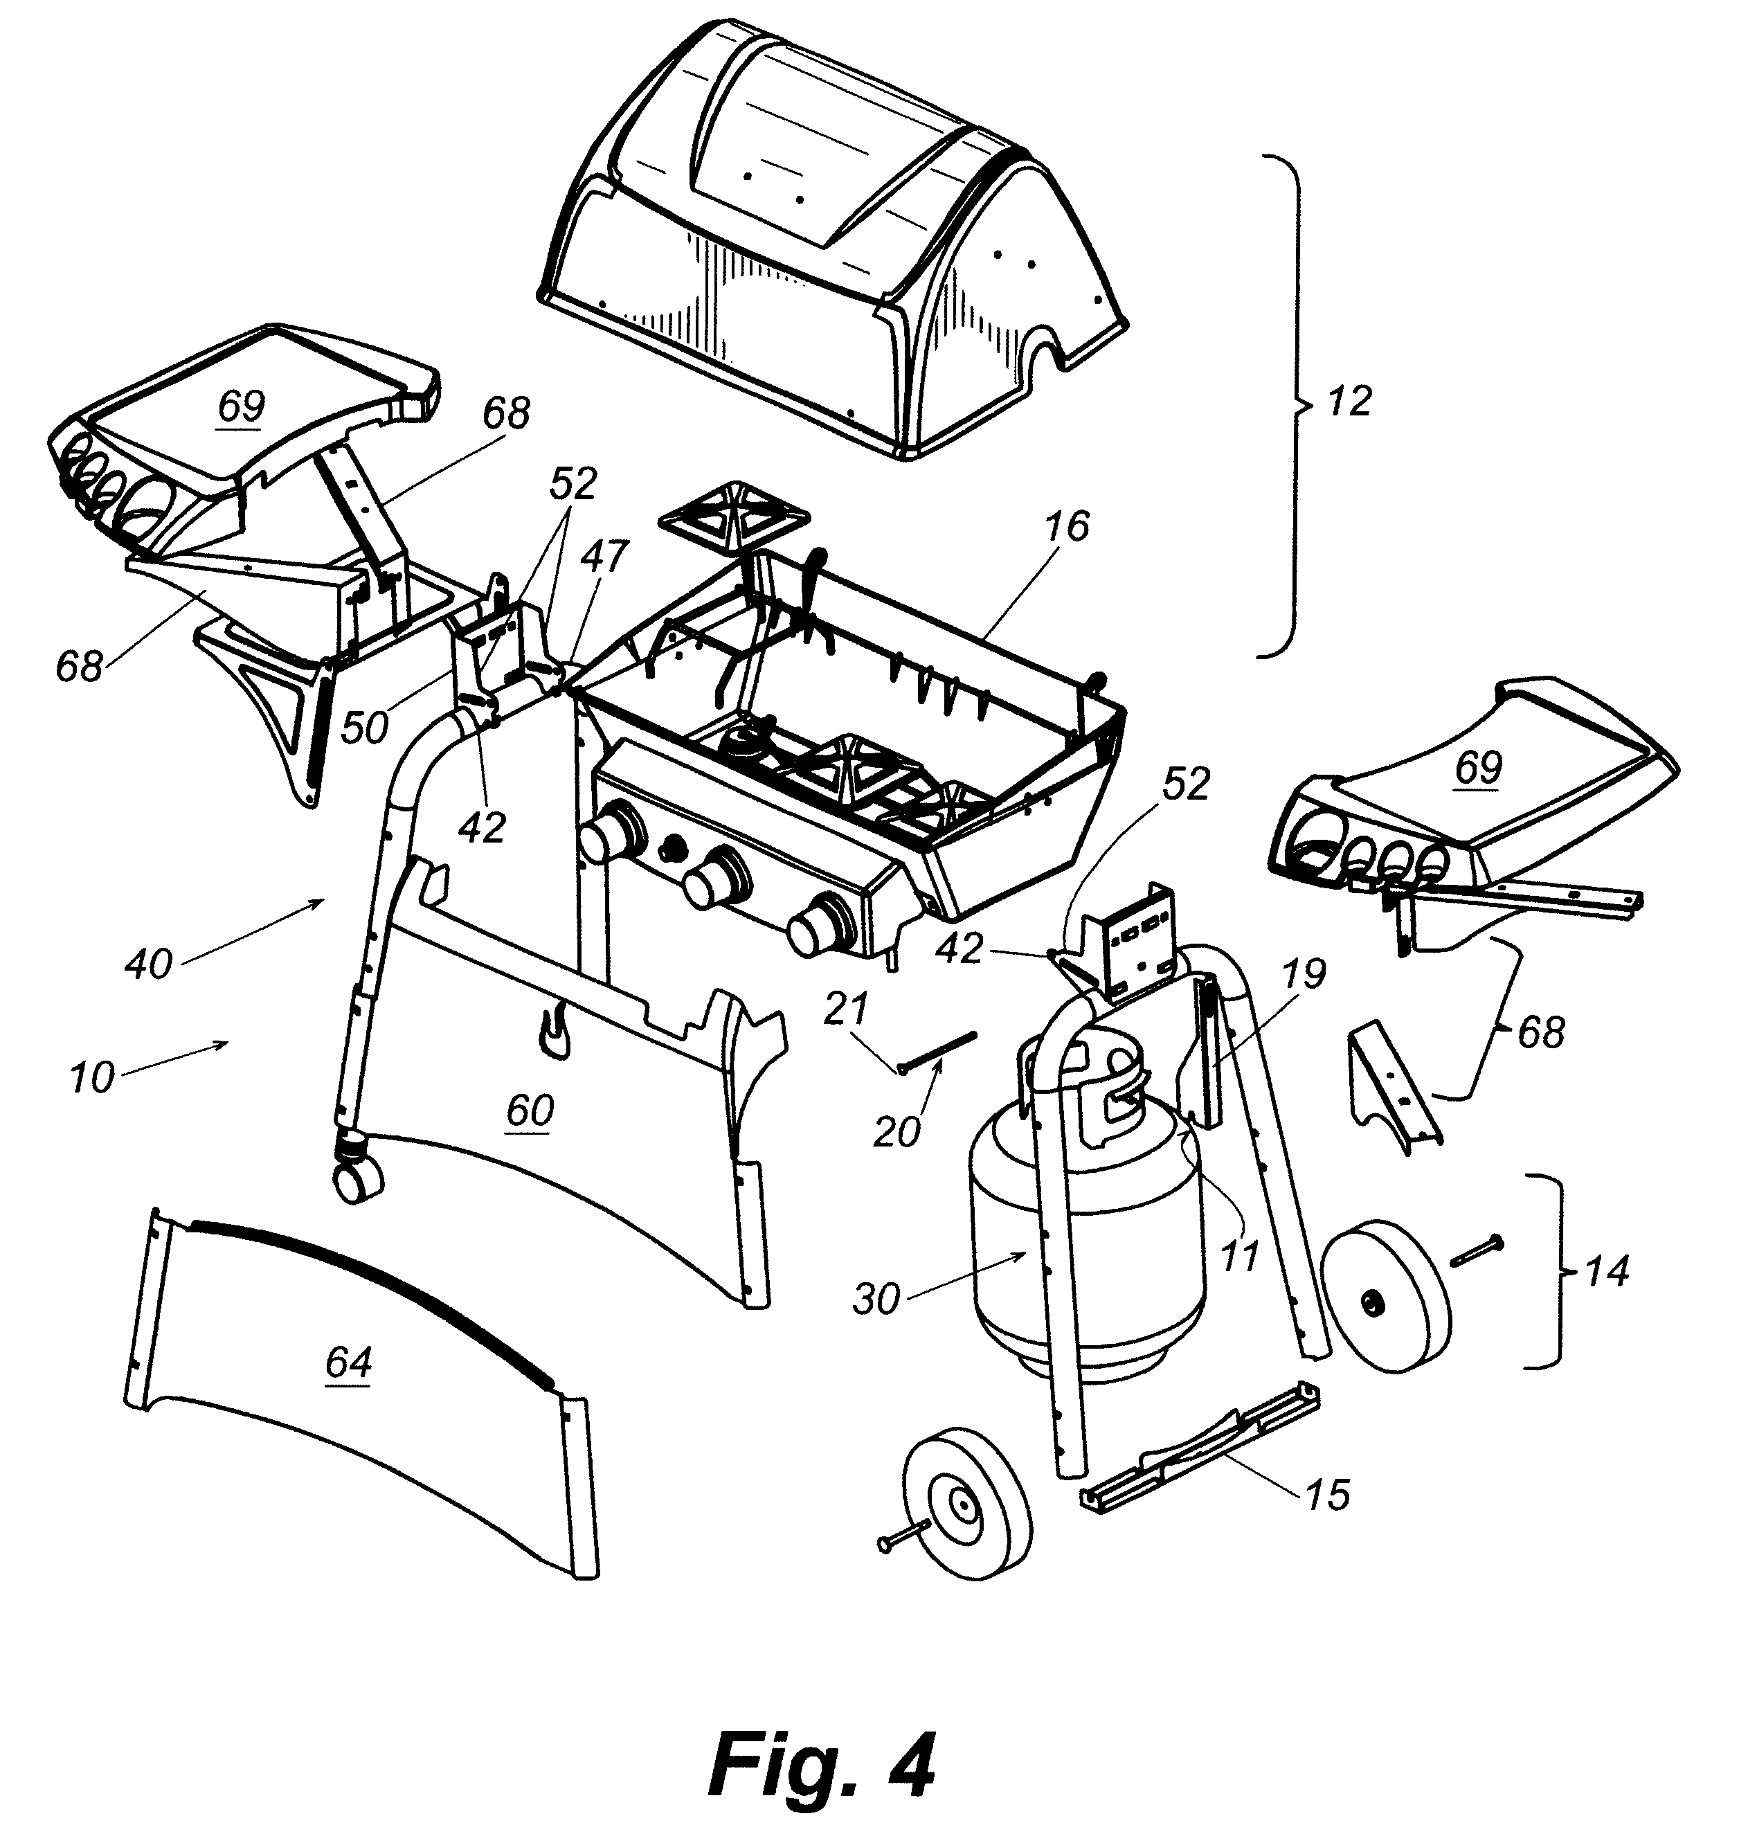
Rapid Assembly Barbeque Grill and Cart

Slide 4
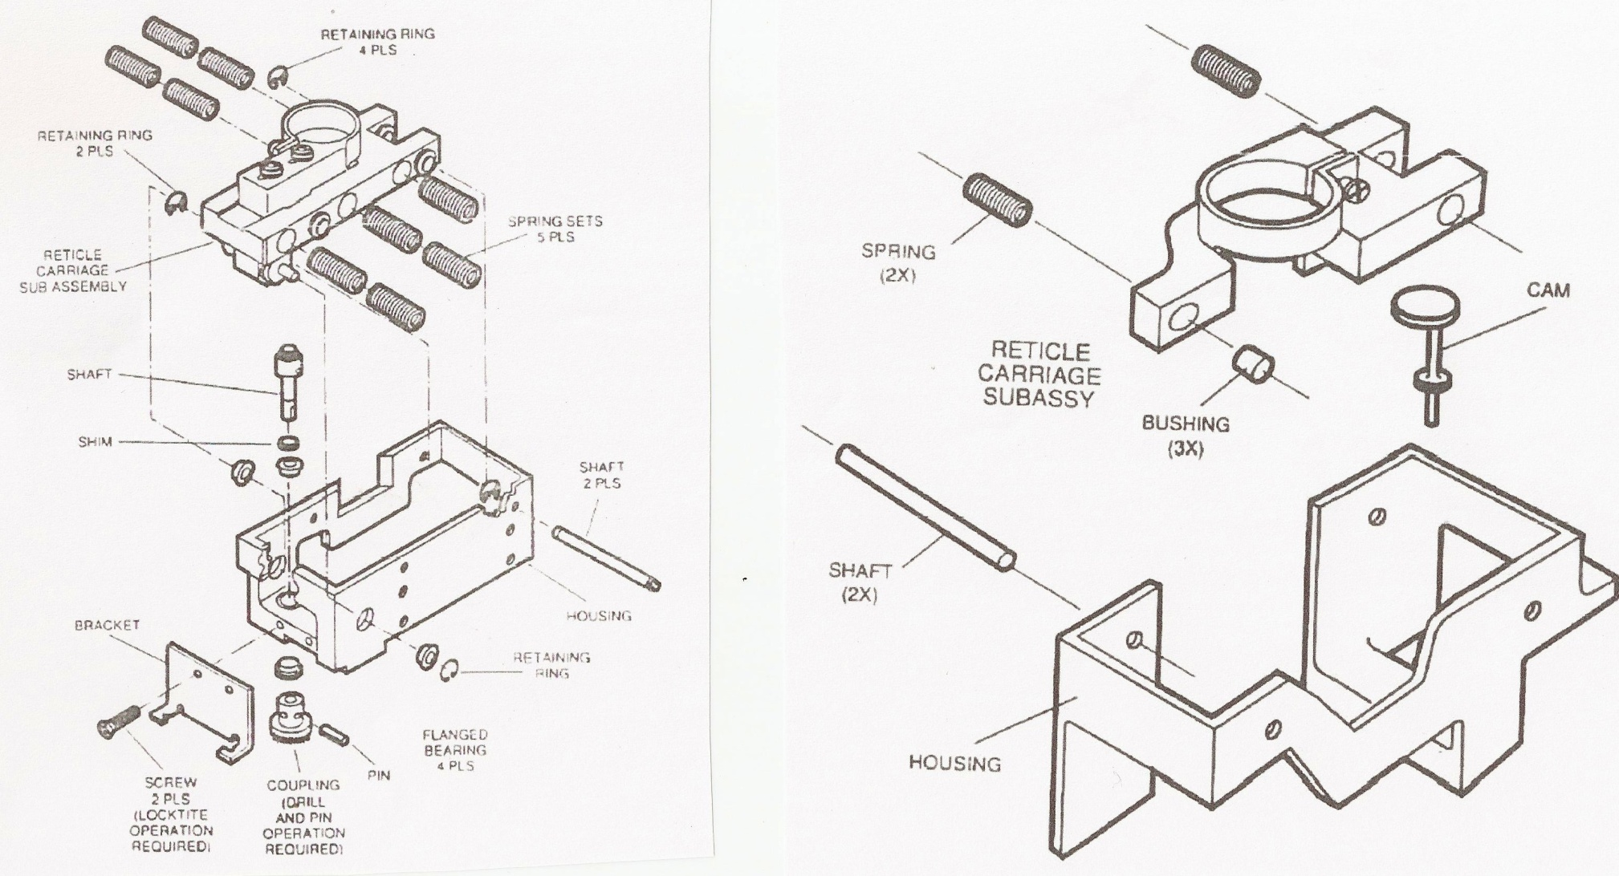
Reticle Assembly Drawing
Before
After

Slide 5
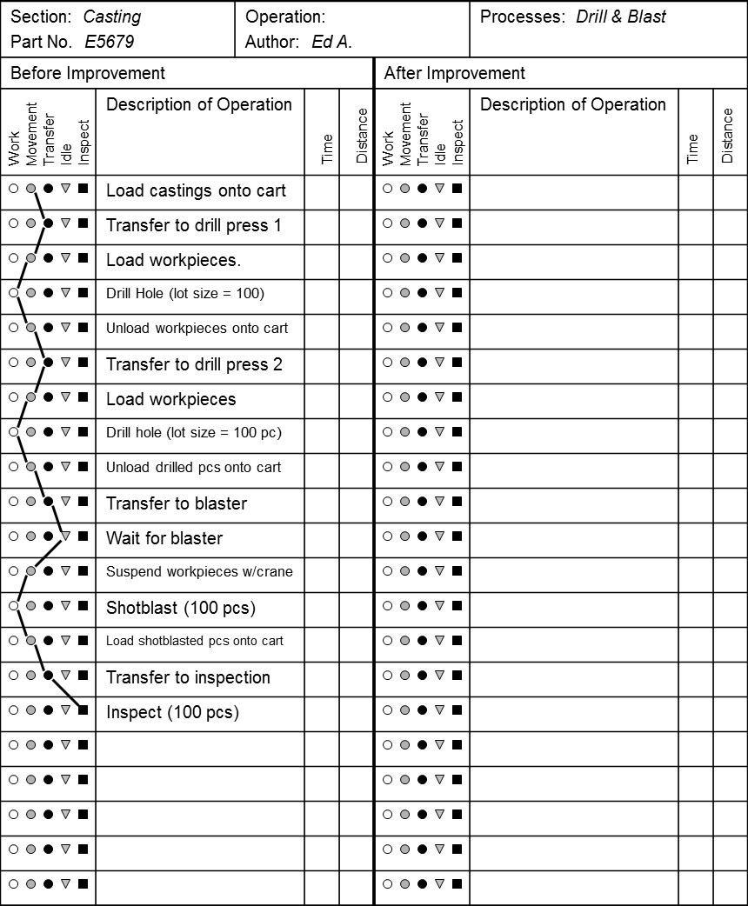
Process Flowchart using “Operations Analysis Table” A Kaizen Tool

Slide 6
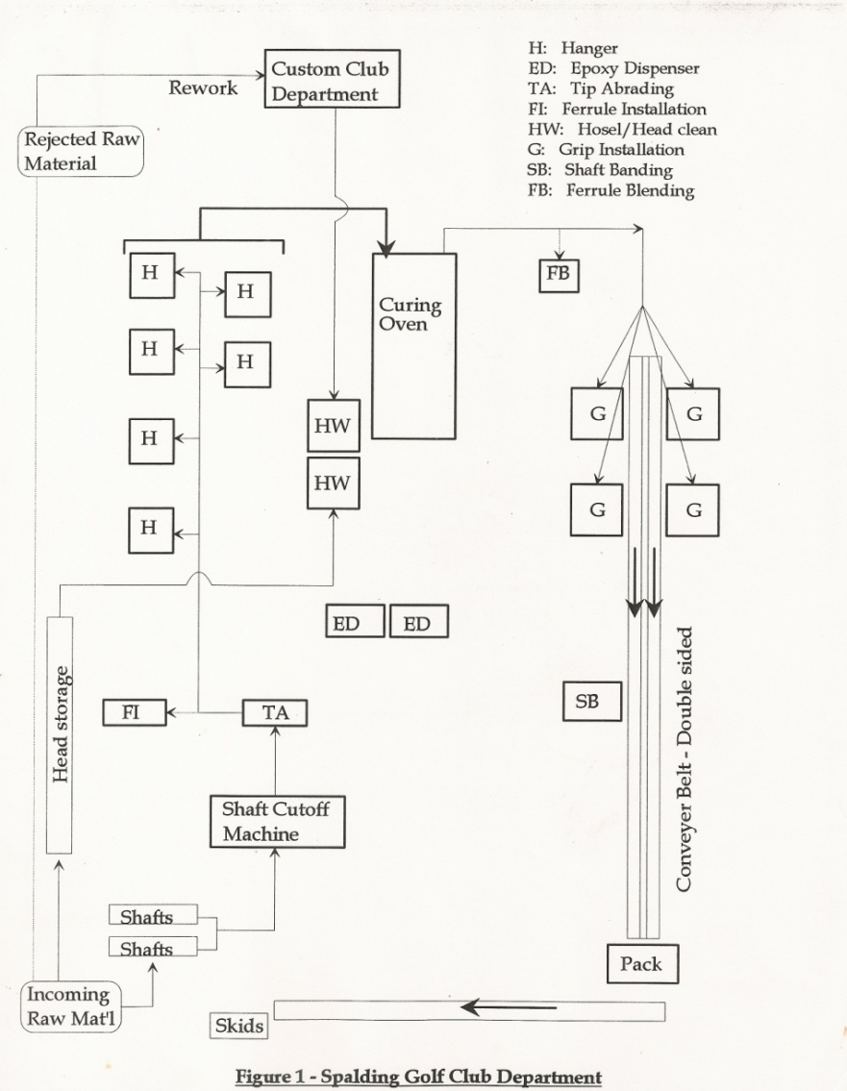
Process Flow Diagram Example Golf Club Assembly Area

Slide 7


Process Map Example: ER Analysis
Arrival
Triage
Registration
Bed
437 patients
Discharge
Treatment
by Triage Priority

Slide 8
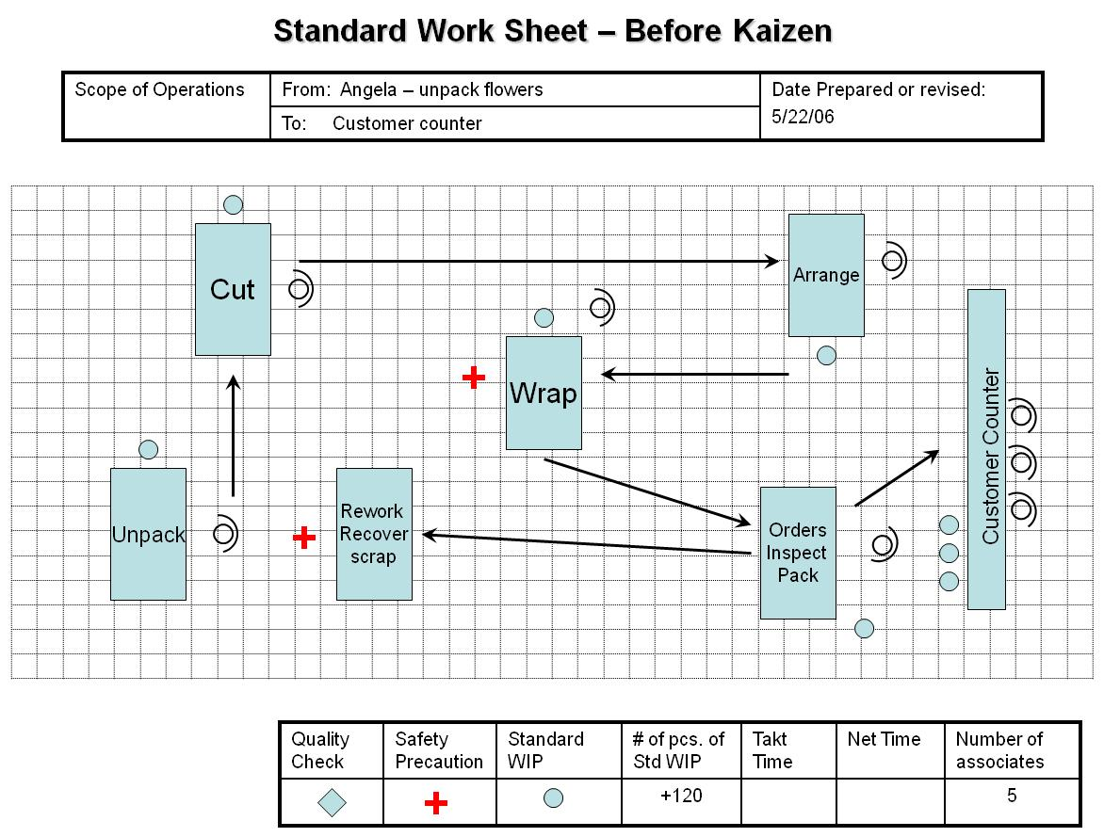
Process Analysis Example Template Commonly used in Kaizen Event

Slide 9
Physical PF Diagram (Spaghetti Diagram)
Stephen
File
File
Denise
Copier
Ann
Jean
Front Counter

Slide 10
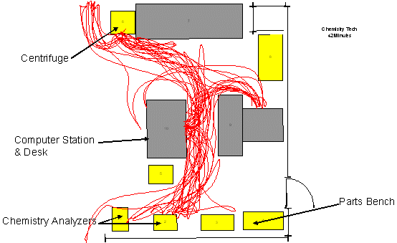
Path Walked from Centrifuge to Analyzers

Slide 11
Linear PF Diagram
Basic process map
Steps are arranged in sequence from top to bottom or left to right
Useful when there are only one or two functions in the process.
Process data can be added to assist in Analyze!
Cycle time
Touch time
Frequency of occurrence
Percentages
Walk into
restaurant
1 min
Check in with
hostess
3 min
Table
available?
13 min
No
Wait
85%
Yes
15%
Walk to table
1 min
Sit at table

Slide 12
Functional PF Diagram
Functional process steps are separated into lanes (“swim lanes”) for each function in the process.
Customer
Counter agent
Lot attendant
Gate attendant
Walk into
office
Line ?
Wait
Drive
to gate
Drive out
of lot
Y
N
Assign
rental car
Obtain
car
Check
out

Slide 13
Make versus Buy: Break-Even Analysis Example
Three alternatives:
Outsource part at $750 per unit (including materials)
Make in-house with process ‘A ‘ at $400/unit (including materials);
Make in-house with process ‘B’ at $150/unit (including materials).
Fixed cost to purchase machinery required for ‘A’ = $50,000
Fixed cost to purchase machinery for ‘B’ = $175,000

Slide 14
Summary of Breakeven Example
Alternative | Description | Equation for Total Cost Curve (D = demand)
1 | Outsource entire unit | $750D
2 | Produce in-house using process A | $400D + $50,000
3 | Produce in-house using process B | $150D + $175,000

Slide 15
Graph for Breakeven Analysis
Revenue at $1000/unit
Outsource
Process B
2
Process A
1

Slide 16
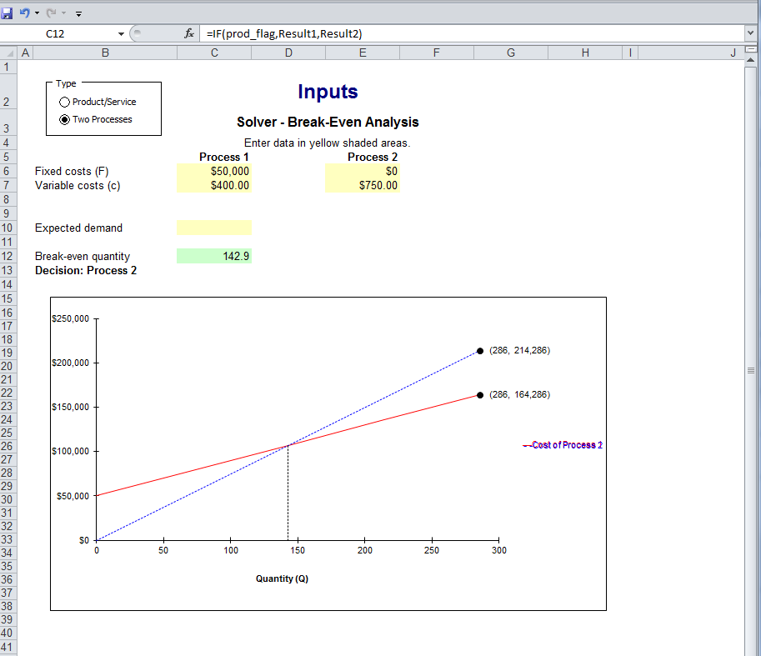
Break-Even Using OM Explorer
OM Explorer>Solver>Decision Making>Break-even analysis

